Slide 1
Data Science: Big Data Management Systems & Tools
Module 6: Analytics with Spark

Slide 2
Module 6 Summary
Spark for processing and performing analytics on massive datasets
Learning Outcomes
Learn how to perform actions and transformations
Use the Spark Machine Learning library (MLlib)
Prepare you to work hands-on with Spark

Slide 3
Spark and its many use cases
Spark can analyze data at rest and in motion…
According to IBM, 60% of all sensory information loses value in a few milliseconds if it is not acted on
Retailers keeping track of the number of people who have said positive things about it’s products today on social media
A law enforcement agency looking for suspects using data from traffic CCTV
Banks detecting anomalies in customer purchase behaviour to detect fraudulent activities (in near real-time). Huge amounts of log data can be combined with external data sources to assess anomalies and breaches.
In the computer games industry, processing real-time in-game events to be able to respond immediately
E-commerce personalized recommendations can be generated by clustering customer transactions and combining customer comments/product reviews to adapt recommendations

Slide 4
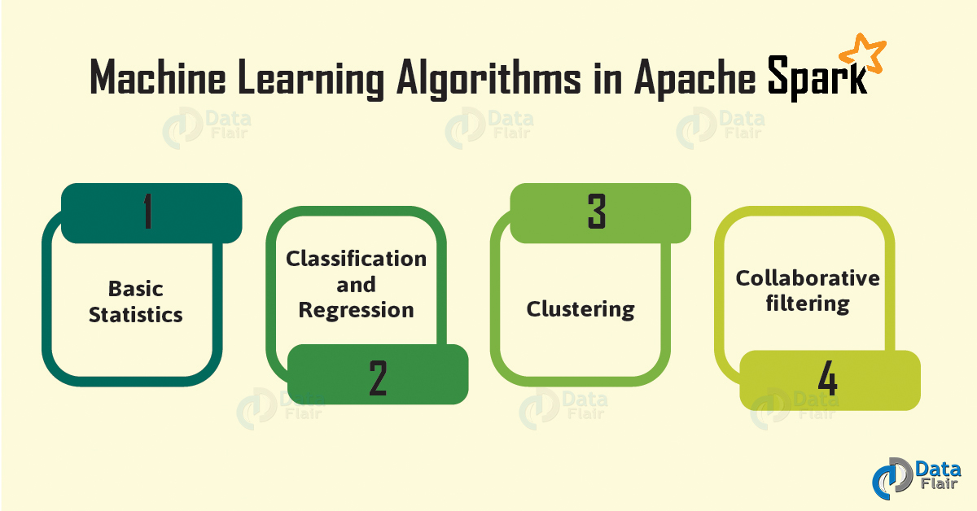
Machine Learning with Spark
Source: https://data-flair.training/blogs/wp-content/uploads/sites/2/2018/01/Machine-Learning-Algorithms-in-Spark-01.jpg

Slide 5
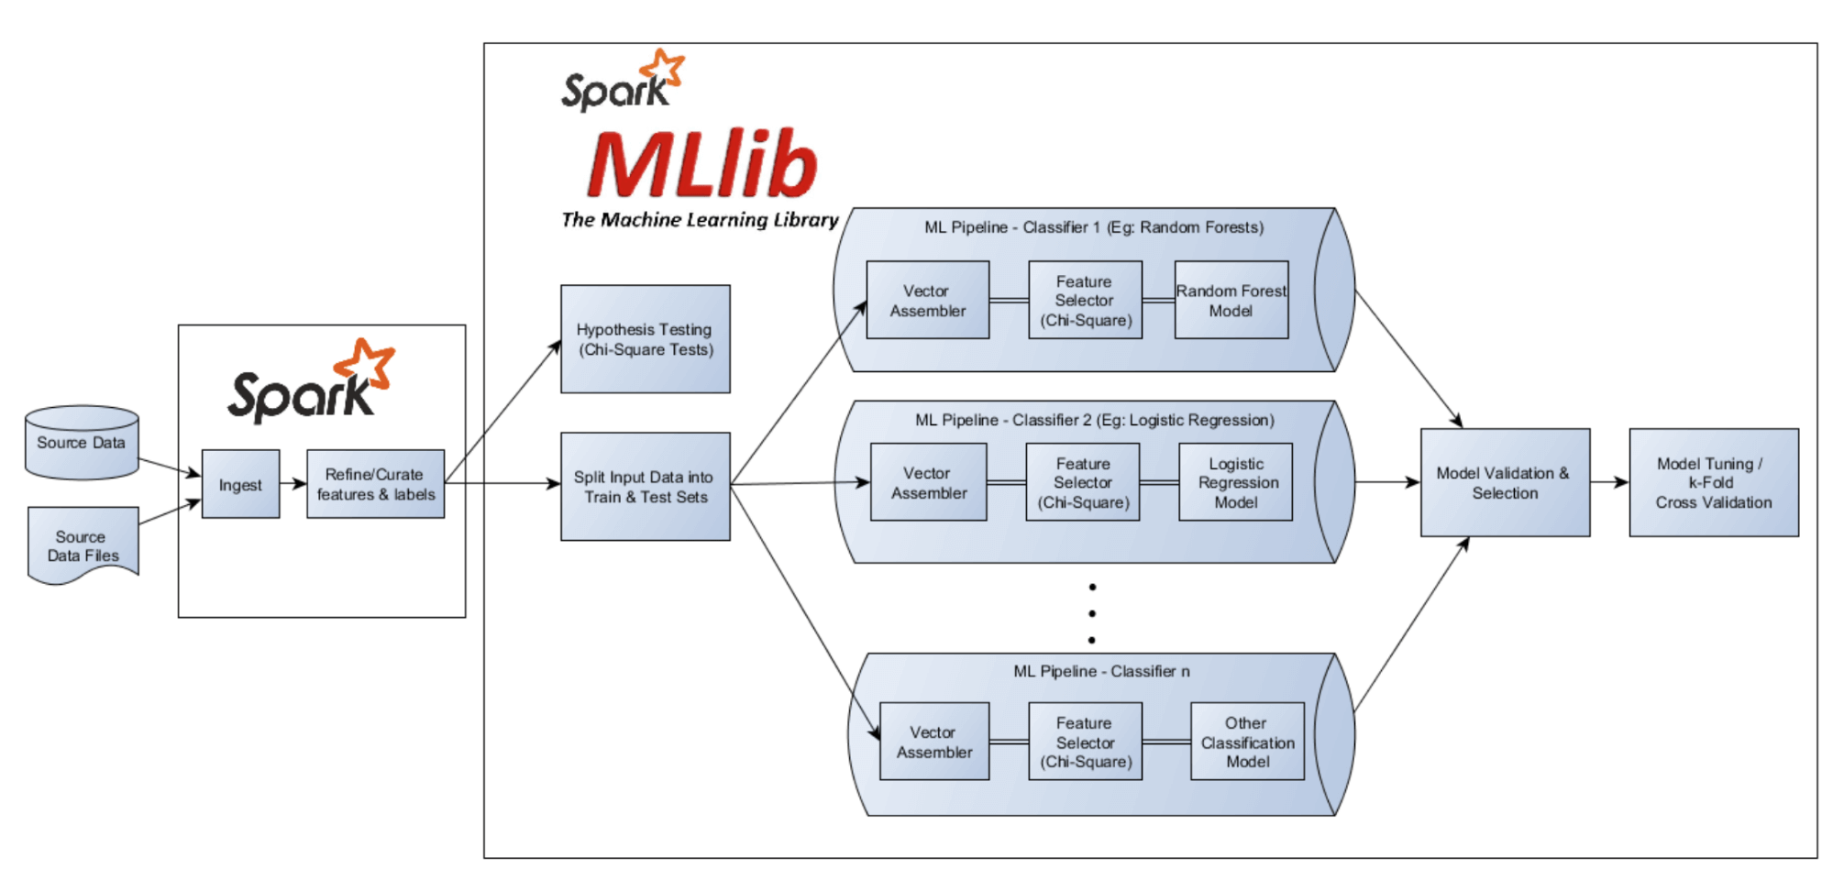
Machine Learning with Spark
Source: https://www.qubole.com/developers/spark-getting-started-guide/workflow
Notes:
Any distributed system for the data source
Spark comes with built in feature engineering
Convert text to int, int to tex
You will need to impute the null values (missing from visual)
Split test and training
Build models, tune parameters
First step is to put data into a vector assembler (special object for spark ML)
Standalone python or R can only train one model at a time, but spark can do multiple models at once

Slide 6
Machine Learning with Spark
ML Algorithms: Common learning algorithms such as classification, regression, clustering, and collaborative filtering.
Featurization: Feature extraction, transformation, dimensionality reduction, and selection.
Pipelines: Tools for constructing, evaluating, and tuning ML pipelines.
Persistence: Tools for saving and loading algorithms, models, and/or pipelines.
Utilities: Tools for linear algebra, statistics, data handling, etc.
A Transformer takes a Spark DataFrame as input and produces an altered DataFrame as output.
An Estimator is an algorithm which has a fit method, usually a machine learning model. When given an appropriate DataFrame as input it can create a model.

Slide 7
Common Spark Functions
How to iterate a dataset like a loop
Example 1:
sc.parallelize([3,4,5]).map(lambda x: range(1,x)).collect()
NOTE: collect: collect returns the elements of the RDD back to the driver program.
Output: Flattened out in a single list, [1, 2, 1, 2, 3, 1, 2, 3, 4]
Source: https://data-flair.training/blogs/apache-spark-map-vs-flatmap/#:~:text=Spark%20Map%20function%20takes%20one,the%20same%20number%20of%20records.

Slide 8
Common Spark Functions
The function in map returns only one element, while the function in flatMap can return a list of elements (0 or more) which can be iterated over.
There is a file greetings.txt in HDFS with the following lines:
Good Morning
Good Evening
Good Day
Happy Birthday
Happy New Year
lines = sc.textFile("greetings.txt")
lines.map(lambda line: line.split()).collect()
Output: [['Good', 'Morning'], ['Good', 'Evening'], ['Good', 'Day'], ['Happy', 'Birthday'], ['Happy', 'New', 'Year’]]
lines.flatMap(lambda line: line.split()).collect()
Output: ['Good', 'Morning', 'Good', 'Evening', 'Good', 'Day', 'Happy', 'Birthday', 'Happy', 'New', 'Year’]
We can do a word count of the file using flatMap:
lines = sc.textFile("greetings.txt") sorted(lines.flatMap(lambda line: line.split()).map(lambda w: (w,1)).reduceByKey(lambda v1, v2: v1+v2).collect())
Output: [('Birthday', 1), ('Day', 1), ('Evening', 1), ('Good', 3), ('Happy', 2), ('Morning', 1), ('New', 1), ('Year', 1)]
Source: https://data-flair.training/blogs/apache-spark-map-vs-flatmap/#:~:text=Spark%20Map%20function%20takes%20one,the%20same%20number%20of%20records.

Slide 9
Spark Transformations and Actions
https://spark.apache.org/docs/latest/rdd-programming-guide.html#transformations
https://spark.apache.org/docs/latest/rdd-programming-guide.html#actions

Slide 10
ML Example - Titanic
On April 15, 1912, during her maiden voyage, the widely considered “unsinkable” RMS Titanic sank after colliding with an iceberg. Unfortunately, there weren’t enough lifeboats for everyone onboard, resulting in the death of 1502 out of 2224 passengers and crew.
While there was some element of luck involved in surviving, it seems some groups of people were more likely to survive than others.
Let’s build a predictive model to predict who was most likely to survive?

Slide 11
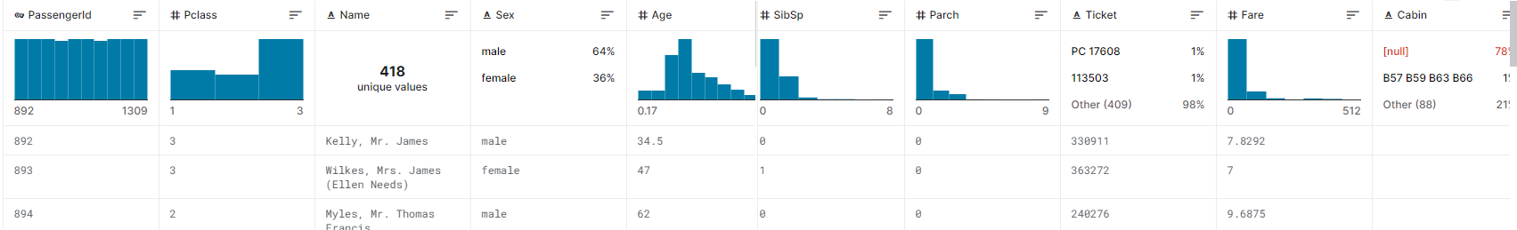
Data
Notes:
Using tool called data mirror

Slide 12
Notebook
Titanic Solution
Notes:
For example, a tokenizer is a Transformer that transforms a DataFrame with text into an DataFrame with tokenized words.
The model is actually a new Transformer (the model takes input examples and produces predictions, a transformation). For example, logistic regression is an Estimator that trains on a DataFrame with labels and features and produces a logistic regression model which can then be used as a Transformer.

Slide 13

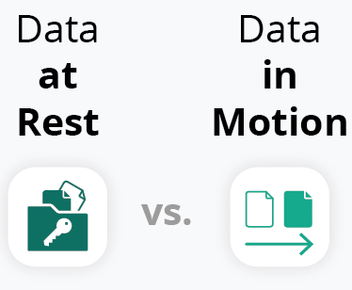
Why is this important?
Ability to tap real-time information for real-time decisioning
A system for all Big Data Seasons – analysing at-rest and in-motion

